Slide 1
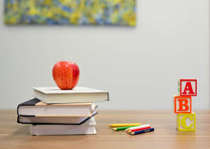
You`ve got a lot of luggage
English lesson for the 6th grade

Slide 2
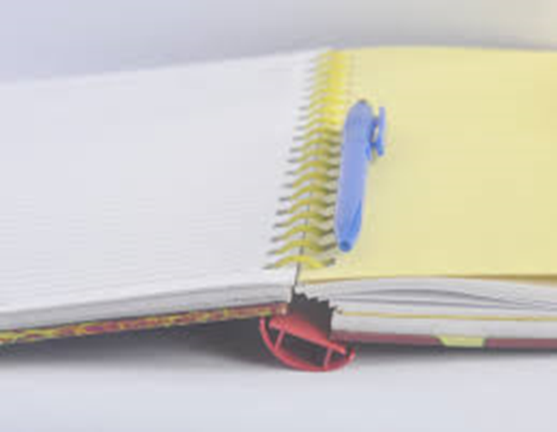
Let`s check the homework
Workbook – page 16

Slide 3
Comparative and superlative adjectives
Short adjectives:
small – smaller – the smallest
big – bigger – the biggest
tasty – tastier – the tastiest
Long adjectives:
exciting – more exciting – the most exciting
Irregular adjectives:
good - better – the best
bad – worse – the worst
far – further – the furthest

Slide 4
New words
luggage /ˈlʌɡɪdʒ/
bags, cases, etc. that contain someone's clothes and things when they are travelling
rubbish /ˈrʌbɪʃ/
things that you throw away because you no longer want or need them
space /speɪs/
a place that is empty
багаж
отпадък
пространство

Slide 5
There is a lot of sugar in the tea.
There are a lof of cars in the street.
There isn`t much milk in the tea.
There aren`t many cars in the street.
How much sugar is there in the tea?
How many cars are there in the street?
There is a little sugar in the tea.
There are a few cars in the street.

Slide 6
Homework
Exercise the new words.

